Slide 1

Recommend a place to live in Phoenix Area
Coursera Capstone Project
Tiffany
9/27/2019

Slide 2
Agenda
Introduction
Description of Background and Problem
Data Description
Data preparation and format
Data cleaning
Feature engineering by getting data from Foursquare
House Price Data
Evaluate the similarity and Give recommendation
Calculate the similarity of the place I live now with the target place
Give the final Score
Further Thinking

Slide 3
Introduction
During the recession, many economic elements, which intimately related to people's lives. The house price belongs to one of these economic elements. During last recession, the house price reached the peak and sharply dropped after the recession began.
I love the place I live in the Columbus, Ohio. But I will move to Arizona, Phoenix Area. I plan to own a house and hope that the community environment of the house, in which I will live, are pretty the same as I’m living right now. I hope the price of the house I will buy won’t drop significant during recession.
Description of Background and Problem

Slide 4
Introduction
House price data: will use the Five-Digit ZIP Codes Annual House Price Indexes (Developmental Index; Not Seasonally Adjusted) to represent the house price.
US zip code with some basic data
Venues data: will use Foursquare API to get the most common venues of given Zip code of Phoenix Area and Columbus.
Data Description

Slide 5
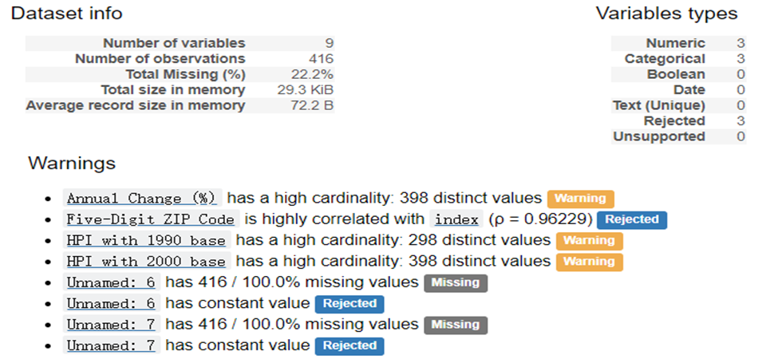
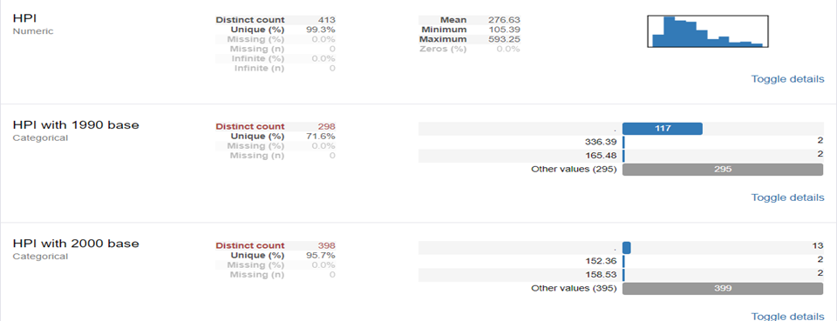
Data preparation and format
House Price data: decide to only use HPI to evaluate the house price of each target place
Data Cleaning

Slide 6
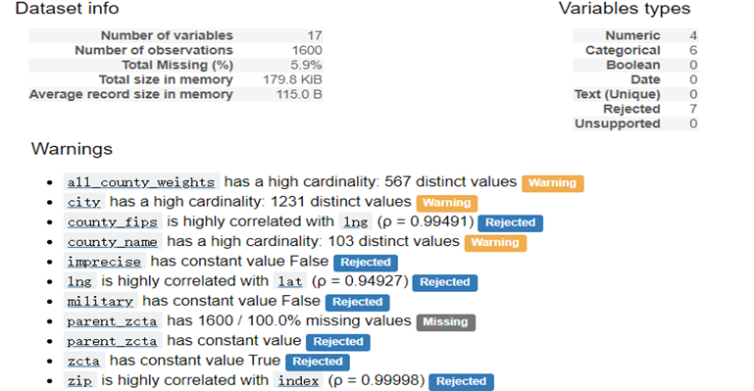
Data preparation and format
Location data: will only use the density, population, which are free from the Internet
Data Cleaning

Slide 7
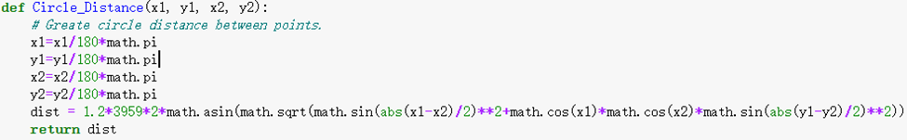
Data preparation and format
Distance calculation:
1. Taking 50km/h as the speed to travel in car, 15 min will take to the 12km away from I live.
2. Consider Manhattan distance and great circle distances as the distance between to place on the earth because of road design.
Feature engineering by getting data from Foursquare

Slide 8
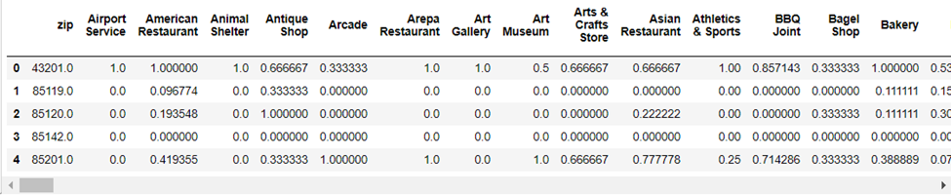
Data preparation and format
Foursquare data: Utilized the Foursquare API to explore the boroughs and segment the neighbor
Feature engineering by getting data from Foursquare

Slide 9
Data preparation and format
To compare the house price, I will treat the house as an investment. Then is easy to give them a score. I choose 4 time points to calculate--2006, 2011, 2014 and 2018. All the 3 points after 2006 will use interest rate 3% as the expected investment response rate to calculate the money:
House Price Data
'score' = ('2014'-‘2006’)*pow(1/z,2014 - 2006 +1) + (‘2011’-‘2006’)*pow(1/z,2011 - 2006 +1) + pow(1/z,2018 - 2006 +1)*( '2018'-‘2006’)/( '2006')*( 'Pay')-( 'Pay')*pow(z,2018 - 2006 +1)

Slide 10
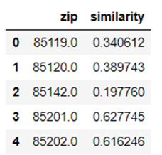
Evaluate similarity and Give recommendation
Calculate the similarity of the place I live now with the target place: There are some different kind of way to calculate the similarity of two data, after evaluated the advantage and disadvantage of the function, I choose cosine similarity.
I directly use scikit-learn.metrics.pairwise.cosine_similarity package to calculate. The following are the sample of result:
Calculate the similarity

Slide 11
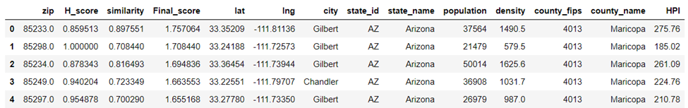
Data preparation and format
Give the final Score by combine the House price score with Location Similarity score(min-max-scaled): five places to be recommended
Give recommendation

Slide 12
Further Thinking
Improving
1. Category can be clustered and be weighted.
2. More detail data like safe level, tax and other factor should be considered.
3. Keep thinking!!!!
Expansion
This project can be used to give recommendation to people who want change city or place to live. The zip code can be change to single house with adding the detail of the house.
Next work

